Slide 1
Encryption and Decryption using Huffman Coding
BY:
Venkateswara Rao Dunne (19BDS0007)
Chandreyi Chowdhury (19MIY0031)
Nikita Anand Joshi (19BCE0666)

Slide 2
CONTENTS
Introduction
Algorithm
Design Methodology
Flow Chart
Example
Pseudocode (Greedy Approach)
Code implementation and screenshot
Output

Slide 3
Introduction
Huffman coding is a lossless data compression algorithm.
In a paragraph not all characters occur with the same frequency yet all the characters are allocated the same amount of space. To solve this problem, we need data compression.
Huffman coding is a method Proposed by Dr. David A. Huffman in 1952 to compress data.
Even though better compression techniques exist in the modern world they only are variations of original Huffman coding.
Hence, we choose this topic to fully understand and try to master this essential part of computer science.

Slide 4
Algorithm
Huffman coding is a data compression algorithm which uses the greedy technique for its implementation.
1. Scan text to be compressed and tally occurrence of all characters.
2. Sort or prioritize characters based on number of occurrences in text.
3. Build Huffman code tree based on prioritized list.
4. Perform a traversal of tree to determine all code words.
5. Scan text again and create new file using the Huffman codes.
Data Structures Used:
Binary Trees

Slide 5
PREFIX RULE
Huffman Coding implements a rule known as a prefix rule.
This is to prevent the ambiguities while decoding.
It ensures that the code assigned to any character is not a prefix of the code assigned to any other character.

Slide 6
STEPS IN HUFFMAN CODING
here are two major steps in Huffman Coding-
Building a Huffman Tree from the input characters.
Assigning code to the characters by traversing the Huffman Tree.
The steps involved in the construction of Huffman Tree are as follows-
Step-01:
Create a leaf node for each character of the text.
Leaf node of a character contains the occurring frequency of that character.
Step-02:
Arrange all the nodes in increasing order of their frequency value.

Slide 7
Step-03:
Considering the first two nodes having minimum frequency,
Create a new internal node.
The frequency of this new node is the sum of frequency of those two nodes.
Make the first node as a left child and the other node as a right child of the newly created node.
Step-04:
Keep repeating Step-02 and Step-03 until all the nodes form a single tree.
The tree finally obtained is the desired Huffman Tree.

Slide 8
TIME COMPLEXITY
The time complexity analysis of Huffman Coding is as follows-
extractMin( ) is called 2 x (n-1) times if there are n nodes.
As extractMin( ) calls minHeapify( ), it takes O(logn) time.
Thus, Overall time complexity of Huffman Coding becomes O(nlogn).
Here, n is the number of unique characters in the given text.

Slide 9
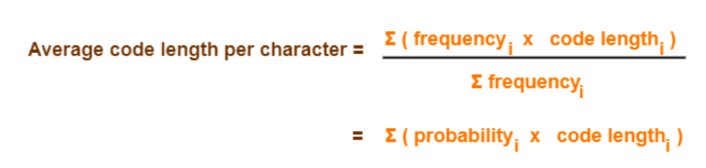
FORMULAS USED
Total number of bits in Huffman encoded message
= Total number of characters in the message x Average code length per character
= ∑ ( frequency_{i} x Code length_{i} )

Slide 10
Design Methodology
Selection of source and destination file of your convenience
A Menu like interface to help people unfamiliar with the program operates it
Encoding and decoding of your files
Works better with larger paragraphs
Small run time
Dynamic Memory allocation
Freeing of allocated memory when program runtime is over to save space
Emergency Exit option in case of a mis click

Slide 11
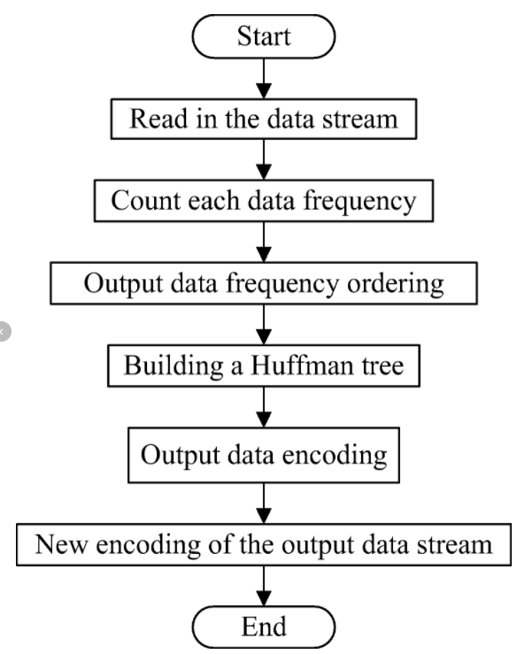
Flow chart

Slide 12
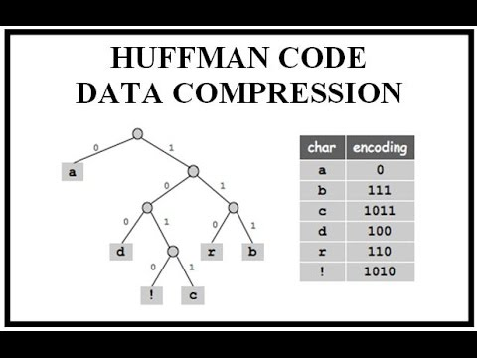
Simple Huffman Coding Example

Slide 13
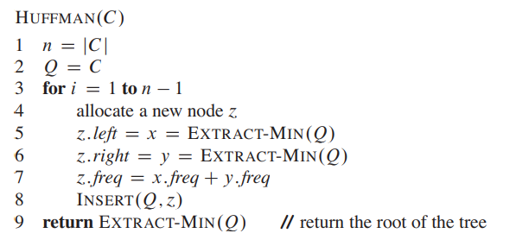
Greedy Approach
Huffman Coding can be implemented in O(n logn) time by using the Greedy Algorithm approach. Huffman Coding is not suitable for a Dynamic Programming solution as the problem does not contain overlapping sub-problems.

Slide 14
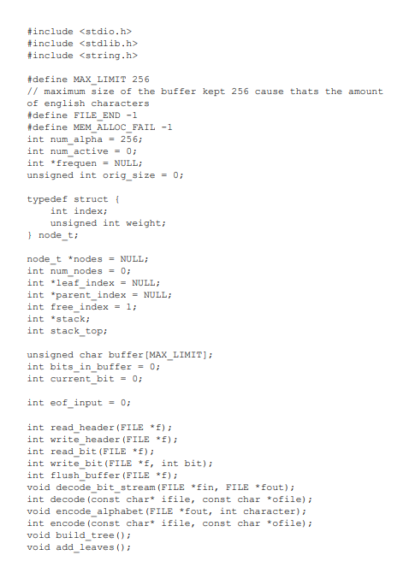
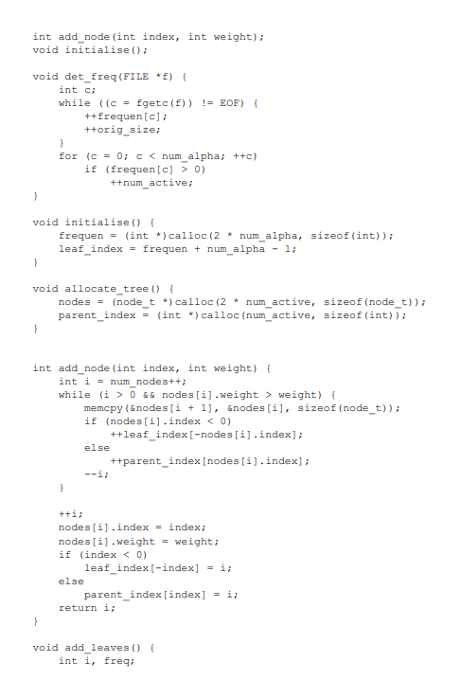
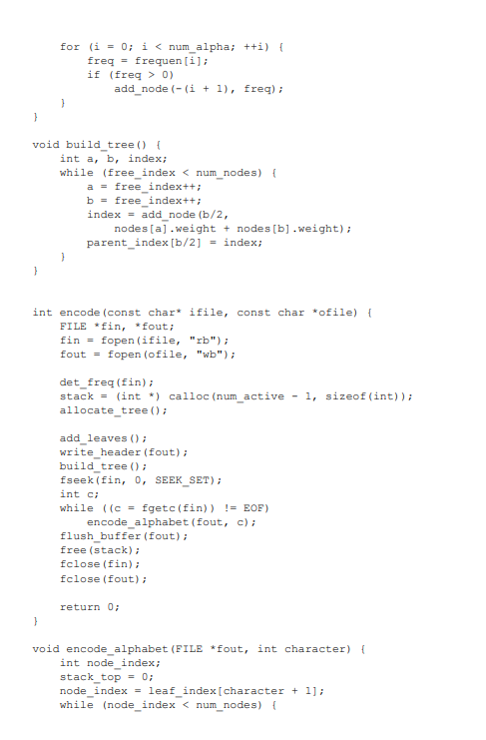
Code implementation

Slide 15
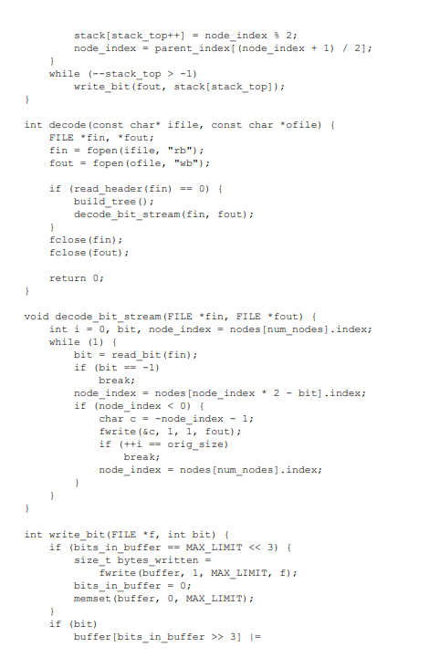
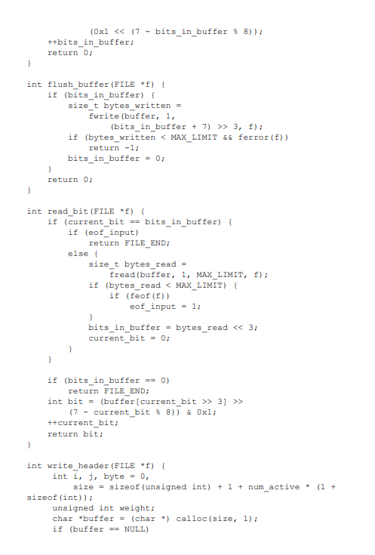
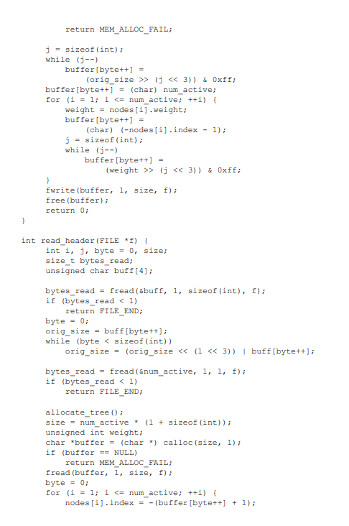

Slide 16
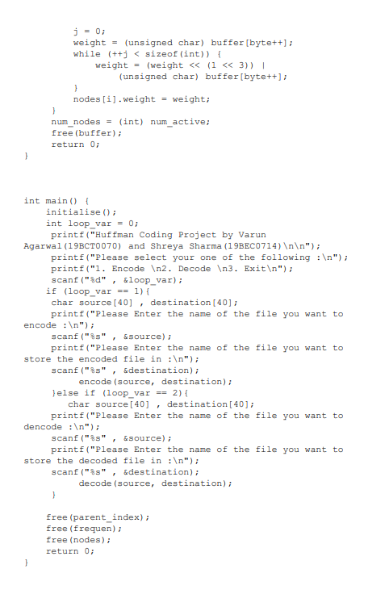
Chandreyi (19MIY0031), and Nikita (19BCE0666) \n\n”);
Venkateswara (19BDS0007),

Slide 17
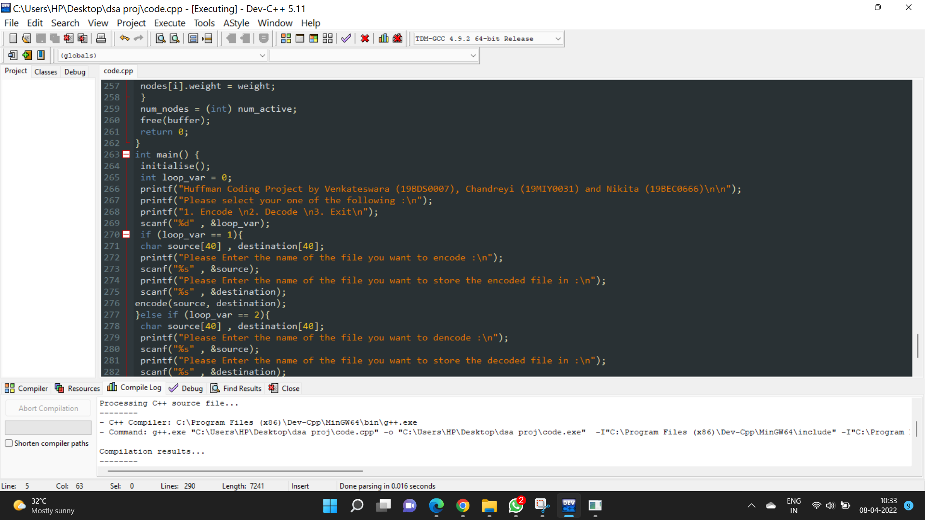
Implementation screenshot

Slide 18
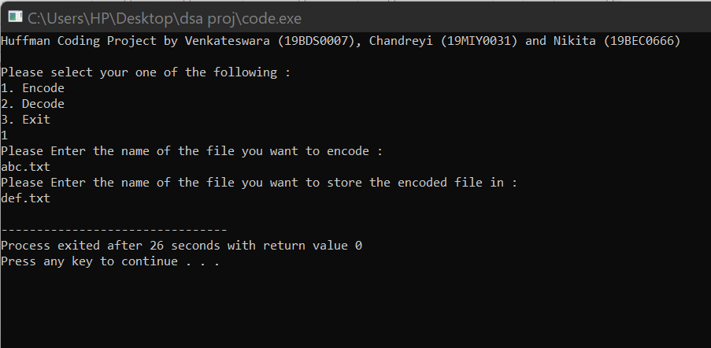
Output

Slide 19
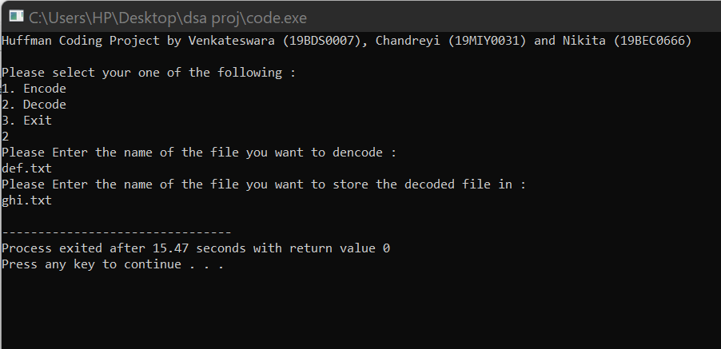
Output 2

Slide 20
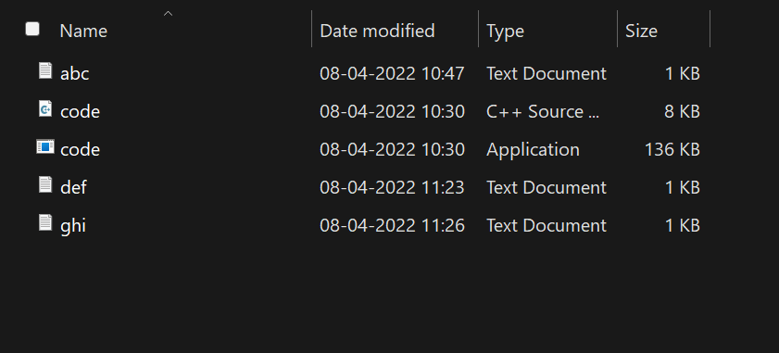
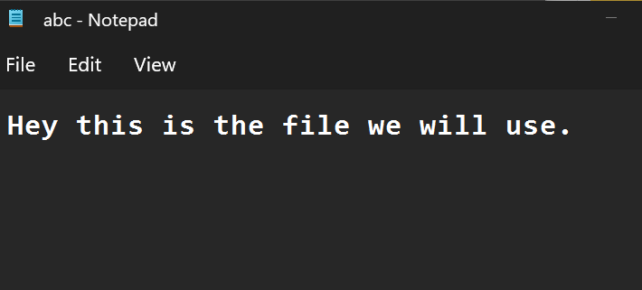
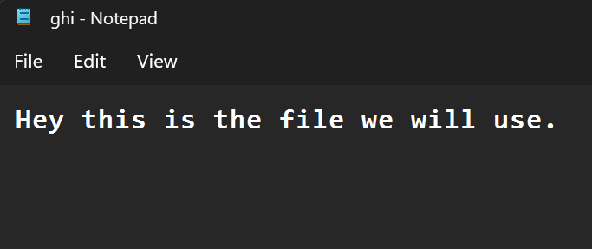
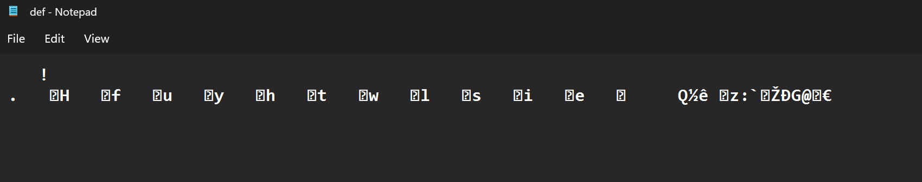
Files created

Slide 21
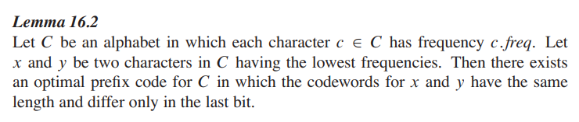
Correctness of Huffman’s Algorithm (greedy)
Proof The idea of the proof is to take the tree T representing an arbitrary optimal prefix code and modify it to make a tree representing another optimal prefix code such that the characters x and y appear as sibling leaves of maximum depth in the new tree. If we can construct such a tree, then the codewords for x and y will have the same length and differ only in the last bit. Let a and b be two characters that are sibling leaves of maximum depth in T . Without loss of generality, we assume that a:freq <= b:freq and x:freq <= y:freq. Since x:freq and y:freq are the two lowest leaf frequencies, in order, and a:freq and b:freq are two arbitrary frequencies, in order, we have x:freq < a:freq and y:freq < b:freq. In the remainder of the proof, it is possible that we could have x:freq = a:freq or y:freq = b:freq. However, if we had x:freq = b:freq, then we would also have a:freq = b:freq = x:freq = y:freq, and the lemma would be trivially true. Thus, we will assume that x:freq ¤ b:freq, which means that x ¤ b.
As Figure 16.6 shows, we exchange the positions in T of a and x to produce a tree T 0 , and then we exchange the positions in T 0 of b and y to produce a tree T’

Slide 22
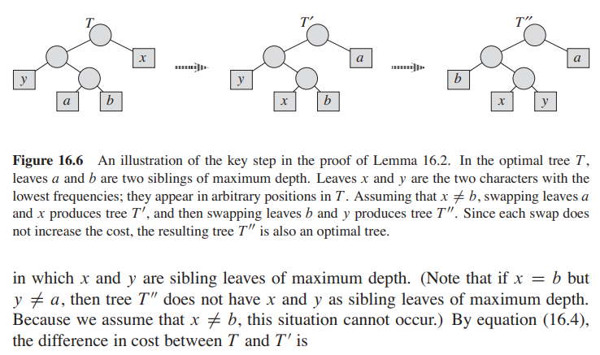

Slide 23
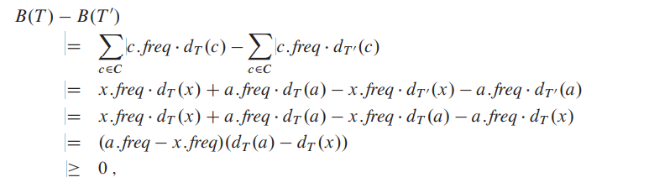
because both a:freq - x:freq and dT .a/ - dT .x/ are nonnegative. More specifically, a:freq - x:freq is nonnegative because x is a minimum-frequency leaf, and dT .a/ - dT .x /is nonnegative because a is a leaf of maximum depth in T . Similarly, exchanging y and b does not increase the cost, and so B.T 0 / - B.T 00/ is nonnegative. Therefore, B.T 00/ <= B.T /, and since T is optimal, we have B.T / <= B.T 00/, which implies B.T 00/ = B.T /. Thus, T 00 is an optimal tree in which x and y appear as sibling leaves of maximum depth, from which the lemma follows.
Lemma 16.2 implies that the process of building up an optimal tree by mergers can, without loss of generality, begin with the greedy choice of merging together those two characters of lowest frequency. Why is this a greedy choice? We can view the cost of a single merger as being the sum of the frequencies of the two items being merged. Exercise 16.3-4 shows that the total cost of the tree constructed equals the sum of the costs of its mergers. Of all possible mergers at each step, HUFFMAN chooses the one that incurs the least cost.
The next lemma shows that the problem of constructing optimal prefix codes has the optimal-substructure property.

Slide 24
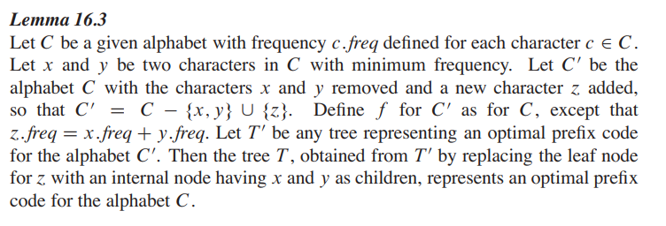
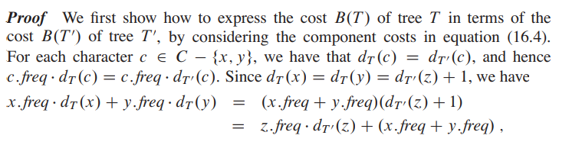

Slide 25
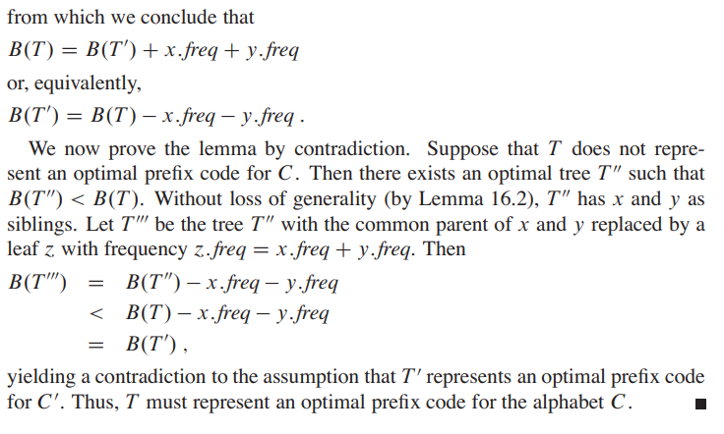

Slide 26
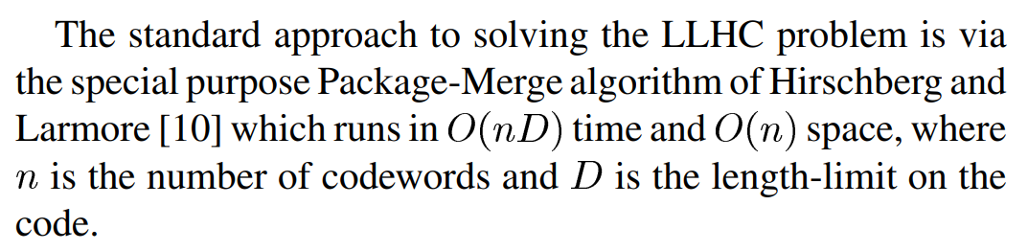
Dynamic Approach
*LLHC: length-limited Huffman coding

Slide 27
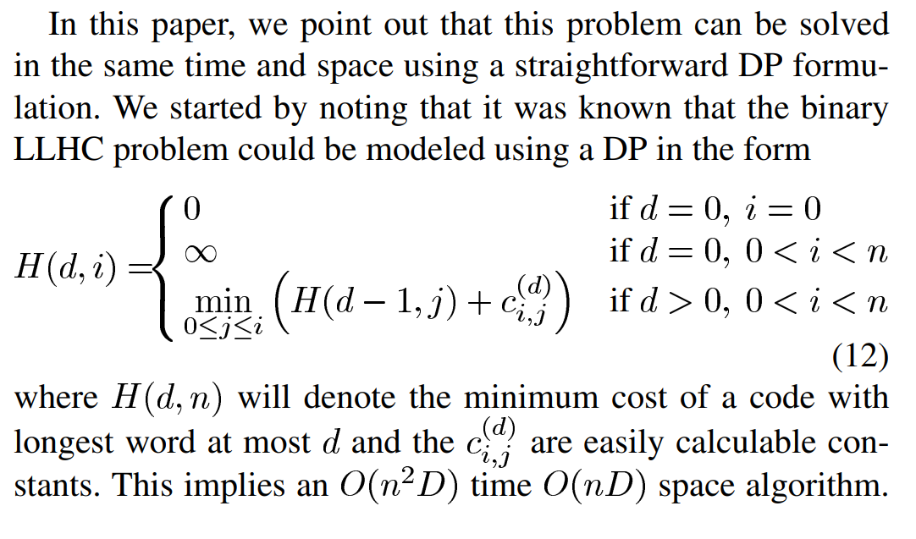

Slide 28

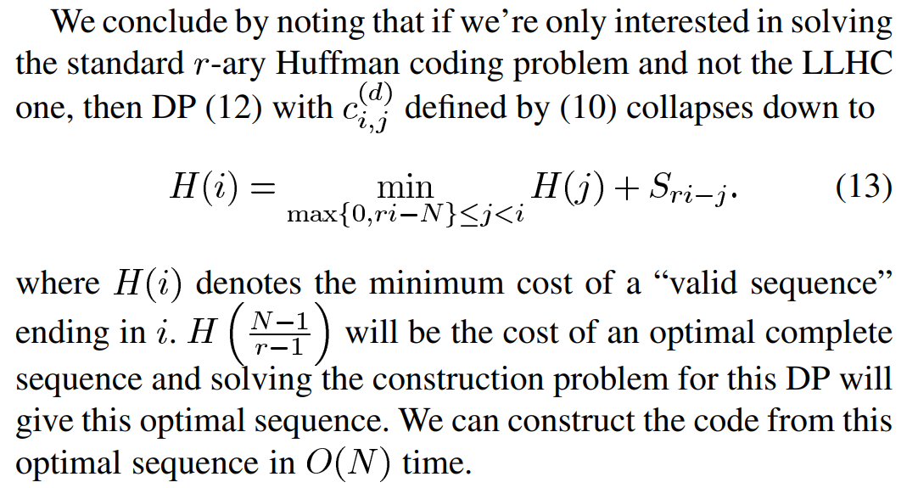
The main contribution of this paper was to note that, once the problem is expressed in this formulation, the space can be reduced down to while maintaining the time at . The space reduction developed for this problem was also shown to apply to the -ary LLHC problem as well as other problems in the literature that previously had been thought to require space.

Slide 29
To summarize, by transforming -ary Huffman coding into a DP and using sophisticated tools, one can solve the problem in time. This is not of practical interest, though, since the simple, greedy, Huffman encoding algorithm is just as fast. Where the DP formulation helps is in the length-limited Huffman coding (LLHC) problem, exactly where the greedy procedure fails. In that case they have the added practical benefit of being able to use the simple SMAWK algorithm. (The SMAWK algorithm is an algorithm for finding the minimum value in each row of an implicitly-defined totally monotone matrix. It is named after the initials of its five inventors, Peter Shor, Shlomo Moran, Alok Aggarwal, Robert Wilber, and Maria Klawe.)
REFERENCES:
Research paper for DP approach: https://ieeexplore.ieee.org/document/5508613
Stackoverflow - Fixing file handling errors
Github - Viewing sample code to understand the concept
Introduction to Algorithms – Thomas Corman (Lemma and Algorithm)

Slide 30
Thank You
BY:
Venkateswara Rao Dunne (19BDS0007)
Chandreyi Chowdhury (19MIY0031)
Nikita Anand Joshi (19BCE0666)

